Slide 1
MS Bike For America
Wesley Matson – Data Analytics Capstone Final Project

Slide 2
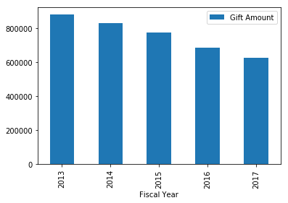
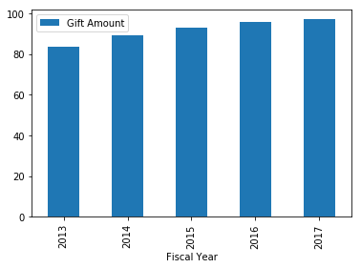
Bike for America 5-year outlook, how can we reverse the trend?
29% Decrease in revenue since 2013
Average donation is steadily increasing

Slide 3
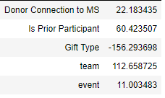
Regression analysis to determine which factors affect gift amount
Regression coefficients:
Intercept: 223.16
Effect on Gift amount:
A donor with connection to MS increases average donation by 22.18
A donation to a prior participant increases average donation by 60.42
A credit card donation decreases average gift amount by 156.29
A donation to a team is 112.66 higher than the average donation
A donation to event is 11.00 higher than average donation

Slide 4
Examine top 3 events with highest average donation
Top 3 events have 6% more offline/check gifts that average
Top 3 events have 10% higher donors who provide email
Top 3 events have 5% higher donors who have a connection to MS
Best events have 3% more team captains
These 4 attributes contributed to a 72.5% (91.20 to 157.60) increase in average donation
Improving these attributes 50% compared top 3 events could lead to an average donation increase of 36.3% to 124.4

Slide 5
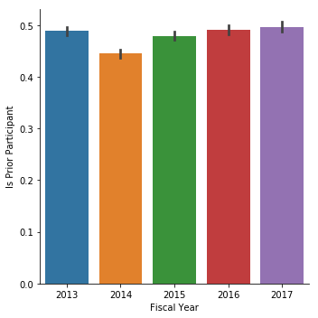
Increase number of riders by increasing retention rate
Percentage of returning riders is holding steady, we can do better
Targeting previous riders will help curb the trend of decreasing number of donations
Returning riders will also provide a boost to average donation
Use logistic regression model to see which attributes are common among riders who return year after year and those who do not
Determine a probability and expected value for each rider to use in a targeted marketing campaign

Slide 6
Regression Details
Response Variable:
Returned – 1 if a rider returned in the following year and 0 if they did not
Explanatory Variables:
Registration active – Current status of registration
Email Status – Whether a participant receives emails
Number from participant – Amount donated by participant
Number not from participant – Amount donated on behalf of participant
Number of years – Total number of years of participation
Registration type – Whether a participant is a volunteer or rider
Model Development:
The list of 2016 riders was used to train the model based on if they returned in 2017
The list of 2017 riders was run through the algorithm to estimate the probability they will return in 2018
Advantages of logistic regression:
Preferred method on analysis when the response variable is binary.
Coefficients can be intuitively interpreted as odds.
By mapping 0 to negative infinity and 1 to positive infinity we transform our response variable into a continuous target

Slide 7
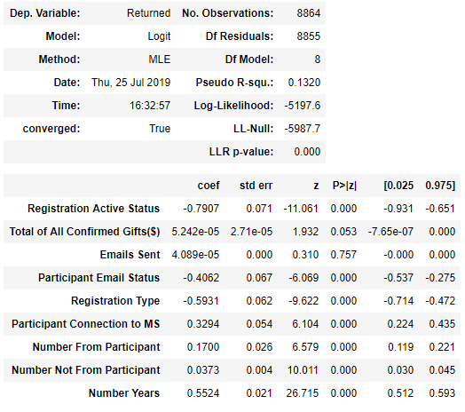
Logistic Regression Model
Factors that negatively affect retention:
Inactive registration status
Inactive email address
Factors that increase retention rate:
Connection to MS
Gift amount from participant
Number of years participated
Not a significant impact
Email Sent
Gift amount not from participant

Slide 8
Logistic Regression Odds
Consider a group of riders in which 10 ride next year and 10 will not:
A change from active to inactive registration status implies 6.2 will ride next year and 13.8 will not
A change from active to inactive email status implies 8 will ride next year and 12 will not
A change from no connection to MS to a connection implies that 11.6 will ride next year and 8.4 will not
An increase on 1 year of participation implies 12.7 will ride next year and 7.3 will not
An increase in donations by 1$ implies 10.8 will ride next year and 9.2 will not

Slide 9
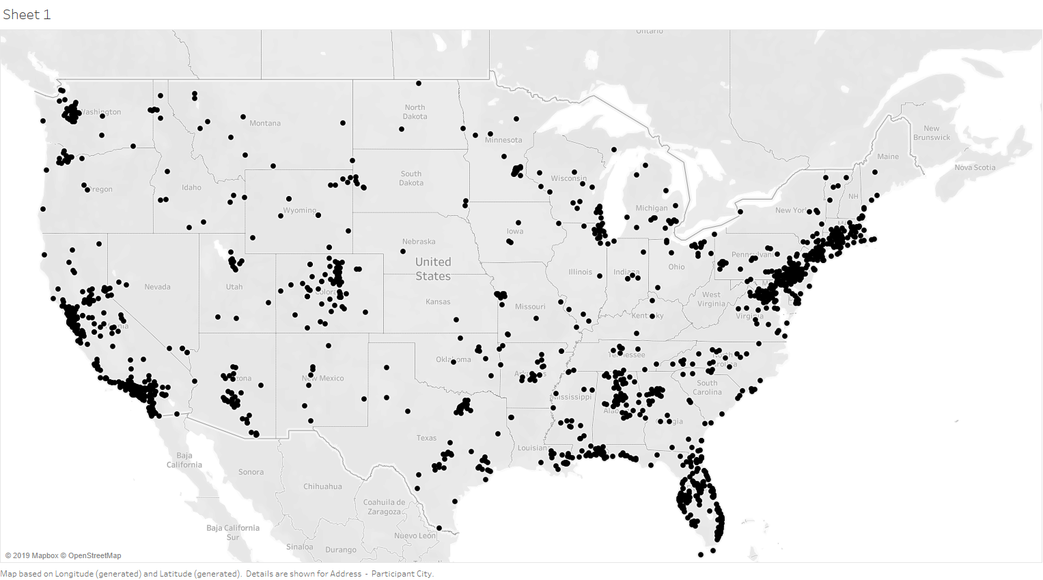
Growth opportunities

Slide 10
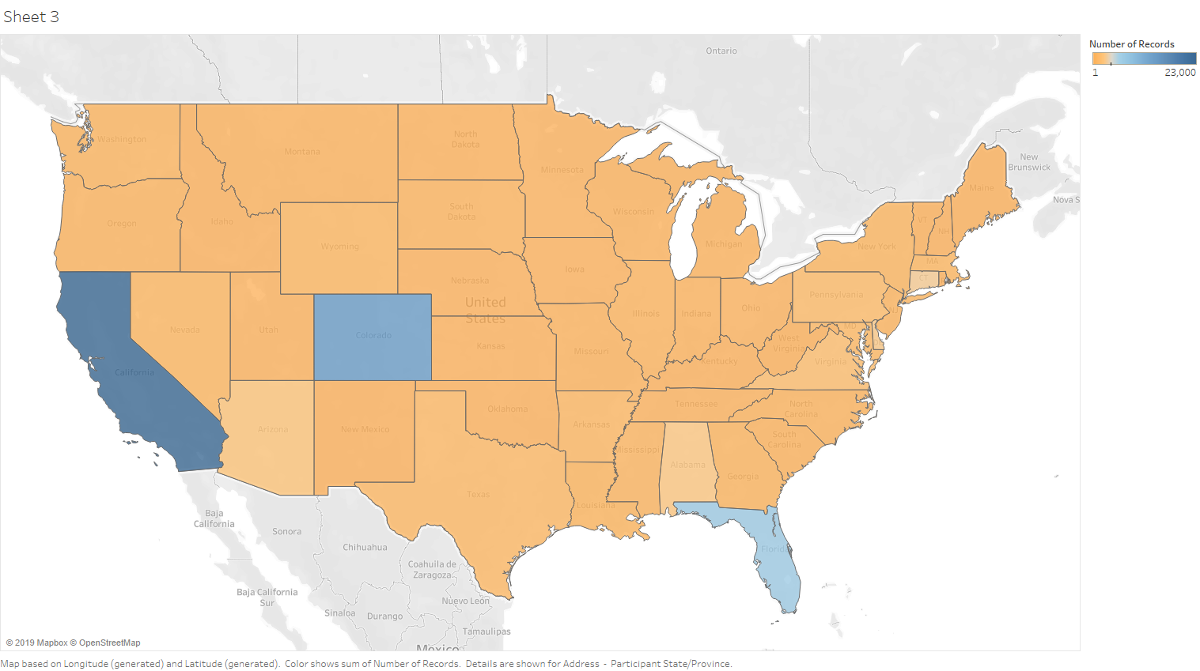
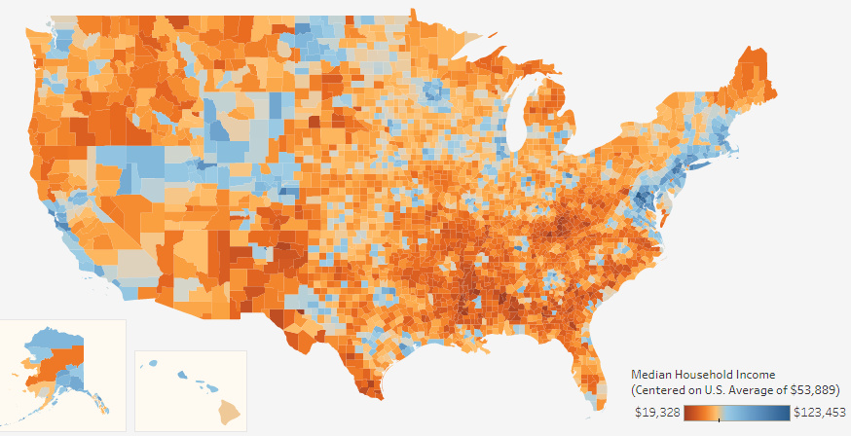
Additional Markets Opportunities on East Cost, Upper Midwest and Washington State and Texas
Number of Riders in each State
Median Income by county

